Slide 1
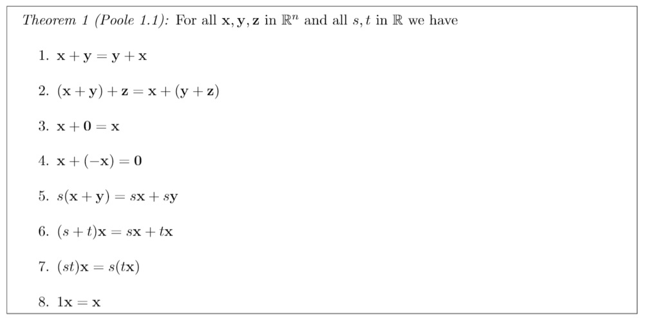
Vector Scalar Properties

Slide 2
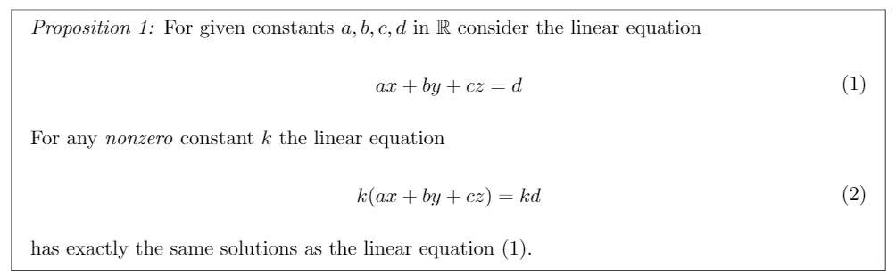
Scaled Linear System Solution

Slide 3
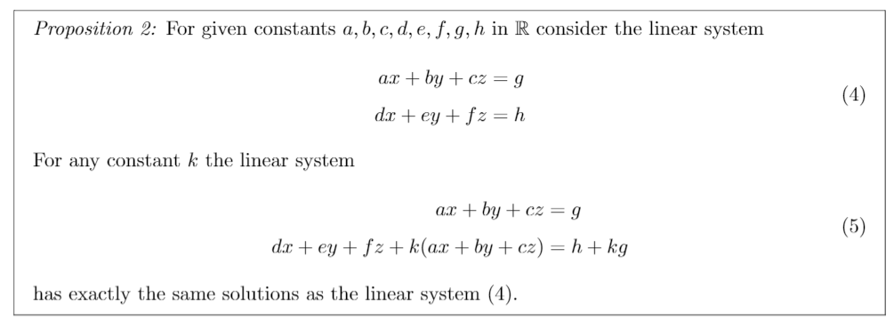
Linear System Solution w/ Modification

Slide 4
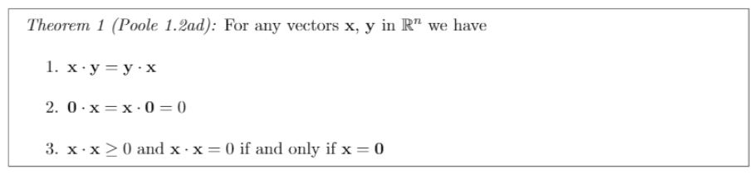
Dot Product Properties

Slide 5
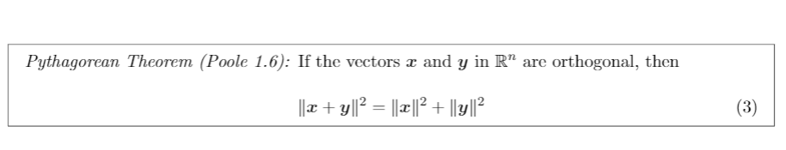
Orthogonal Vector Property

Slide 6
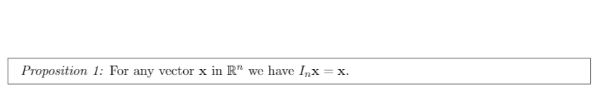
Identity x Vector

Slide 7
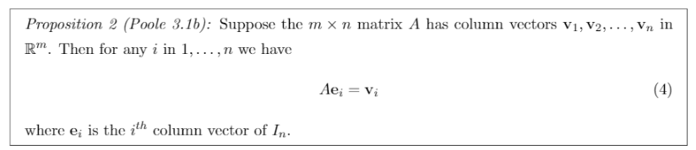
Identity Column Vector Property
Notes:
ei corresponds to the ith column vector in an identity matrix.

Slide 8
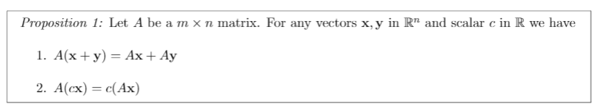
Matrix Properties

Slide 9
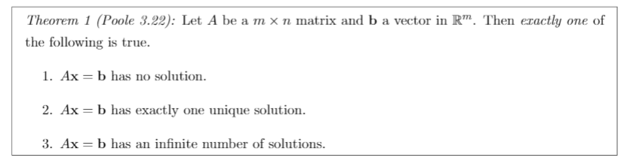
Number of Matrix Solutions

Slide 10
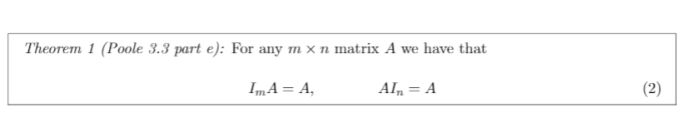
Identity Matrix Properties

Slide 11
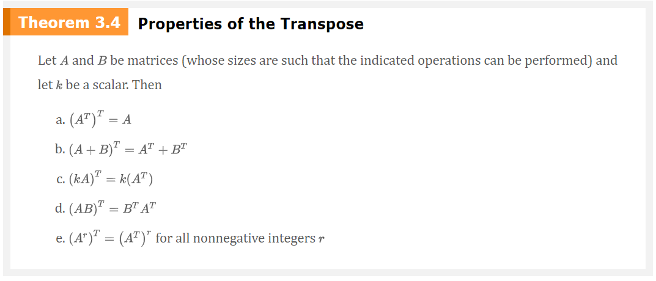
Transpose Matrix Properties
Notes:
e and c are not in notes

Slide 12
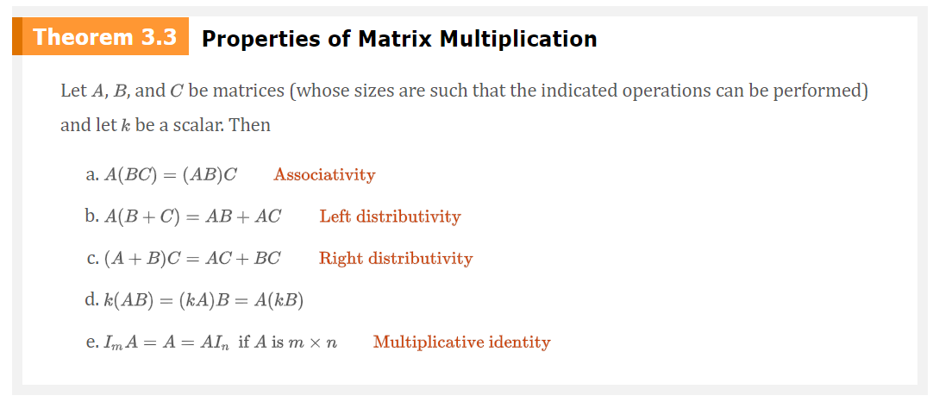
Matrix Multiplication Properties

Slide 13
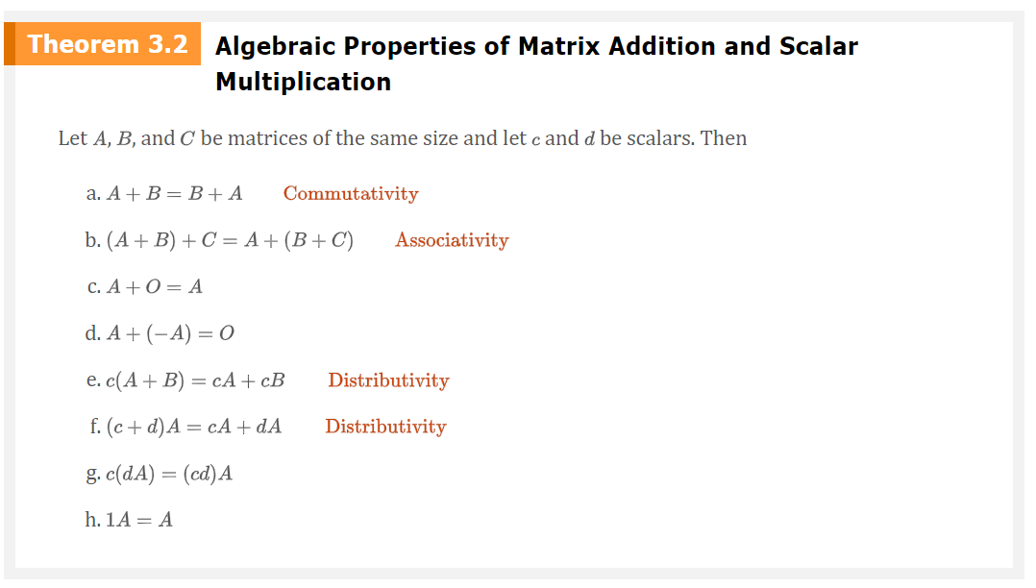
Algebraic Matrix Properties

Slide 14
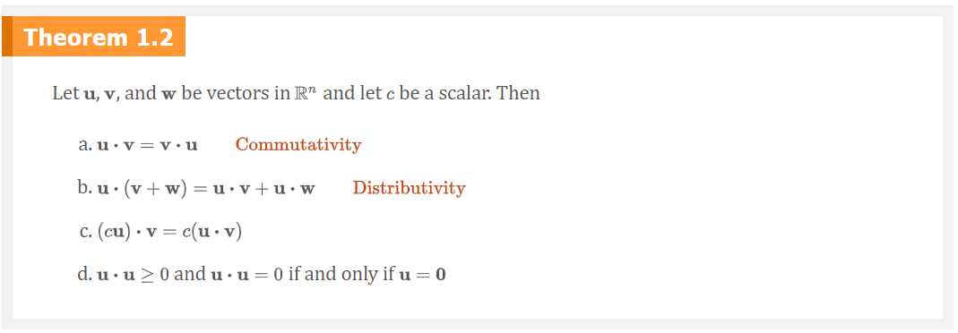
Dot Product Properties

Slide 15
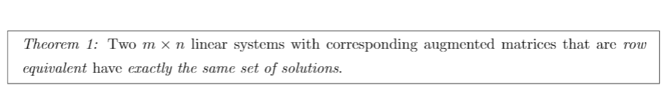
Row Equivalent Matrix Solutions

Slide 16
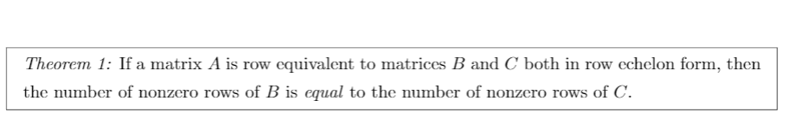
Row Equivalent Nonzero Rows

Slide 17
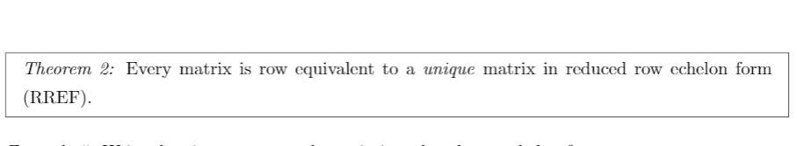
Unique Row Echelon Form

Slide 18
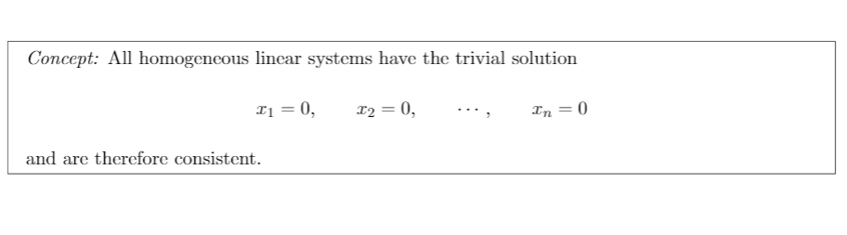
Trivial Solution

Slide 19
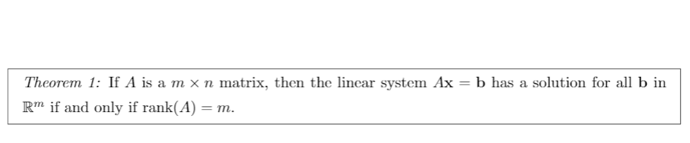
Rank & Solution Relation

Slide 20
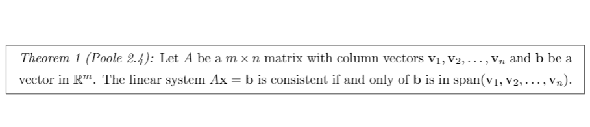
Span and Consistency

Slide 21
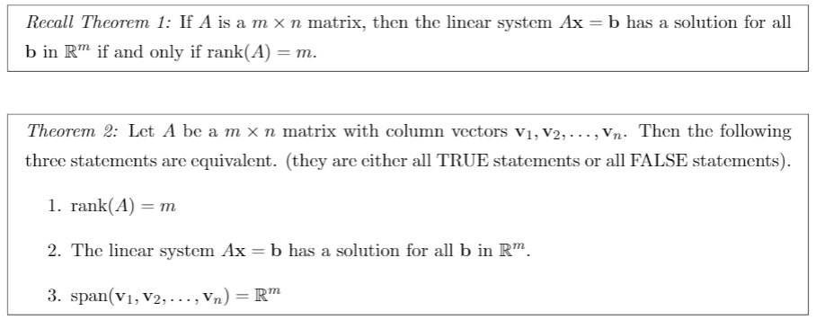
m x n Matrix Properties

Slide 22
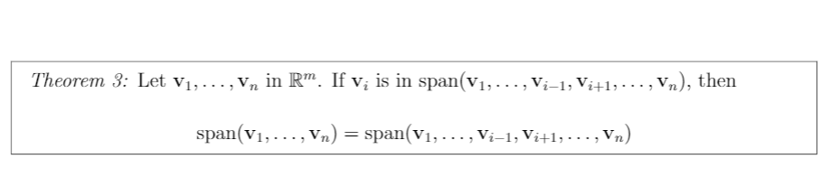
Redundant Span Vector

Slide 23
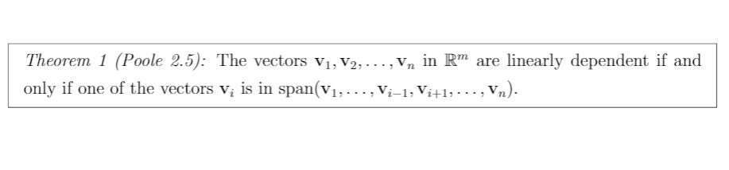
Redundant Vectors & Linear Dependence

Slide 24
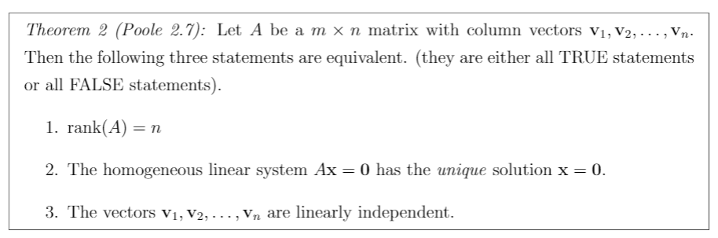
Linear Independent Matrix Properties

Slide 25
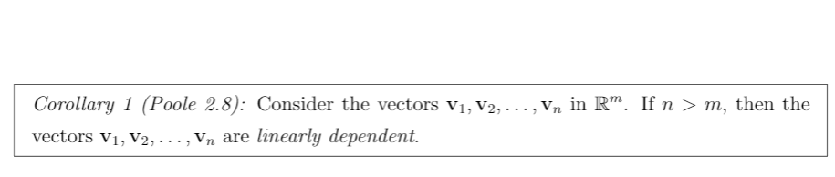
Linear Dependent Matrix Property

